Slide 1
Human interface types
Dr. Y S Rao
Input:
  Switch
  Push button
  Keypad
Output:
  light-emitting diode (LED)
  Seven-segment LED
  Liquid crystal display (LCD)
1

Slide 2
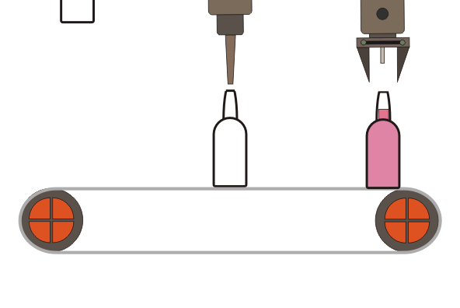

Slide 3


Slide 4
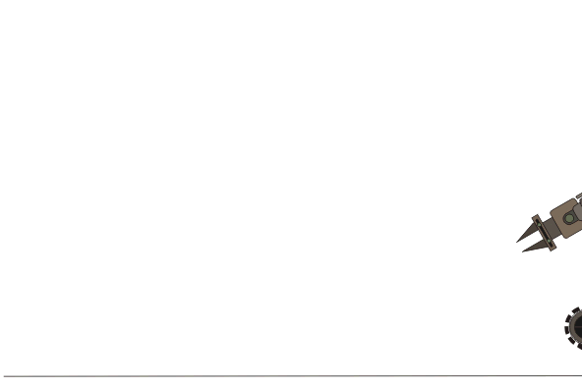

Slide 5
Terminology
Pin – This is a physical point that connects the microcontroller to the outside world.
I/O – Input /Output
Input – This is an input pin
Output – This is an output pin
Bidirectional I/O – This is pin which can be configured as either input or output.
Port I/O register= This is a data register that is physically connected to a set of I/O pins
Control register = This a control register used to configure the operation of a data port or some other function on the controller.

Slide 6

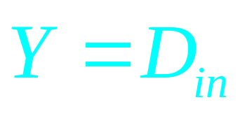
Input Buffer
Din
Equation
Input pin
Symbol
Truth Table
Din | Y
0 | 0
1 | 1

Slide 7
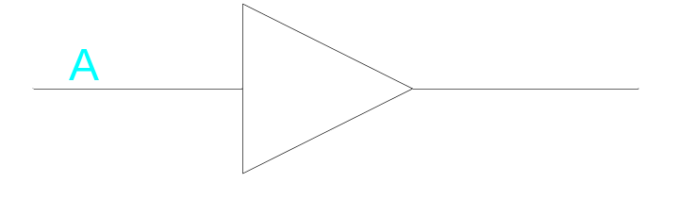

Output Buffer
Dout
Equation
Symbol
Output pin
Truth Table
A | Dout
0 | 0
1 | 1

Slide 8
Another meaning of “buffer”
The word buffer is also frequently used in computer engineering to refer to a region of storage (registers or memory) that is used to hold data temporarily while it is being (or waiting to be) sent or received.
  This usage is contrasted with an electrical buffer (previous slides) which just amplifies and delays a signal.

Slide 9
Tri-state drivers
(Three-state drivers)

Slide 10
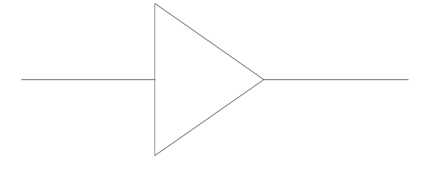
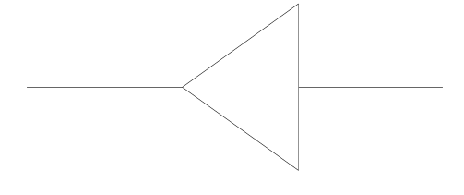
Multiple Outputs
Y
lower
A
Y
Y
A
0
1
raise
Chip A
Chip B
Let A_A = 0
Let B_A = 1
What is Y?
Unknown
X

Slide 11
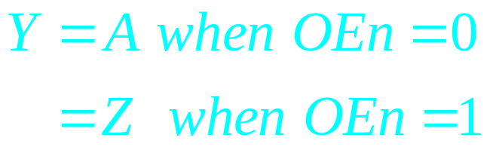
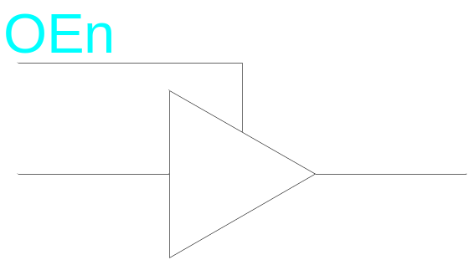
Tri-State Driver
Active-low signal “OEn”
(Output Enable)
Equation
Symbol
Truth Table
A | OEn | Y
d | 1 | Z
0 | 0 | 0
1 | 0 | 1
High Impedance State
“Open Circuit”

Slide 12
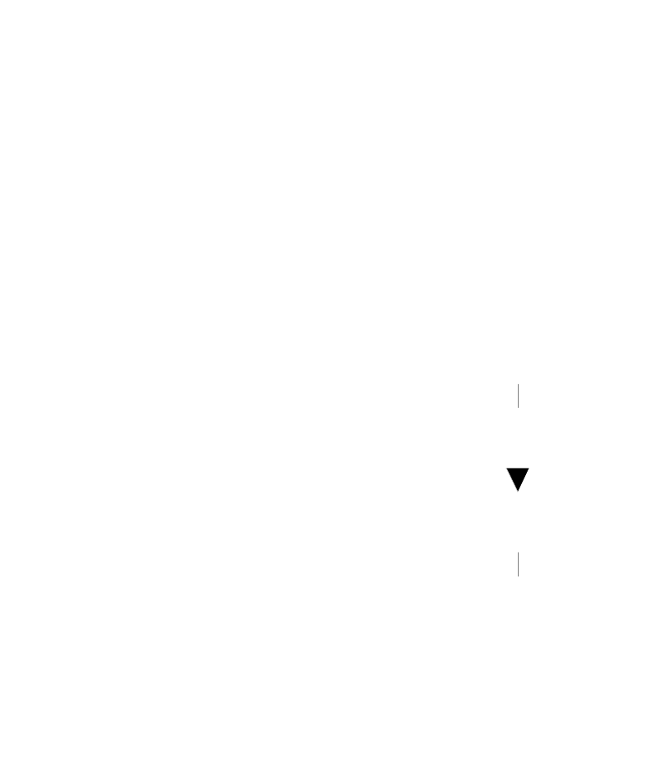
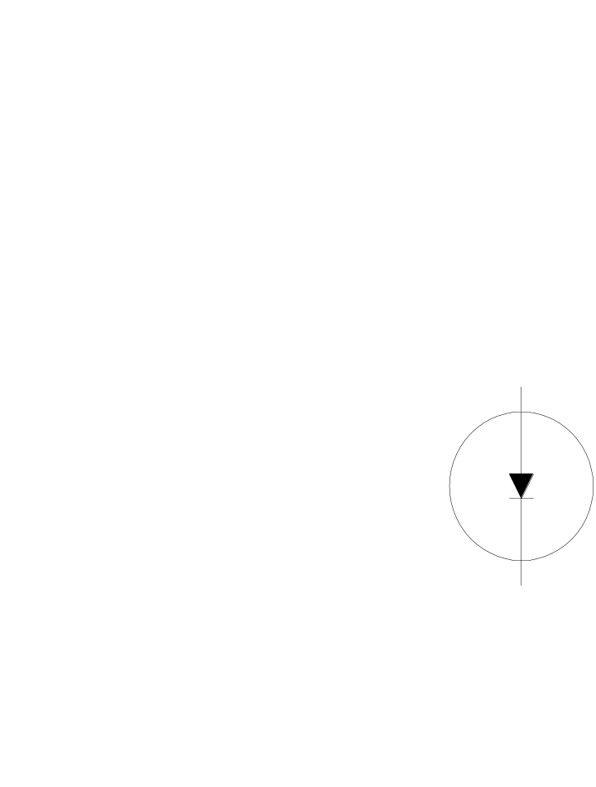
LED Circuit Example
Switch
Light On
Light Off

Slide 13
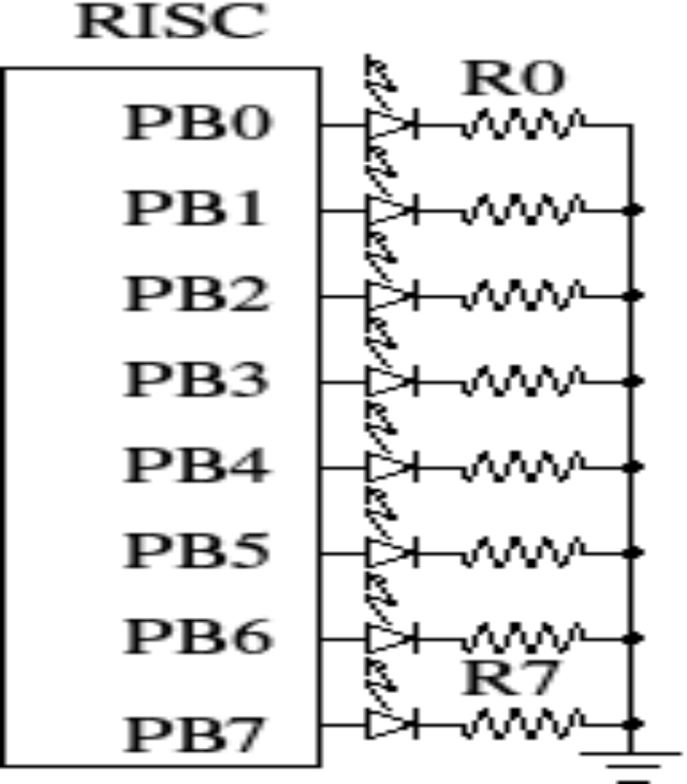

LED Direct Intrface

Slide 14
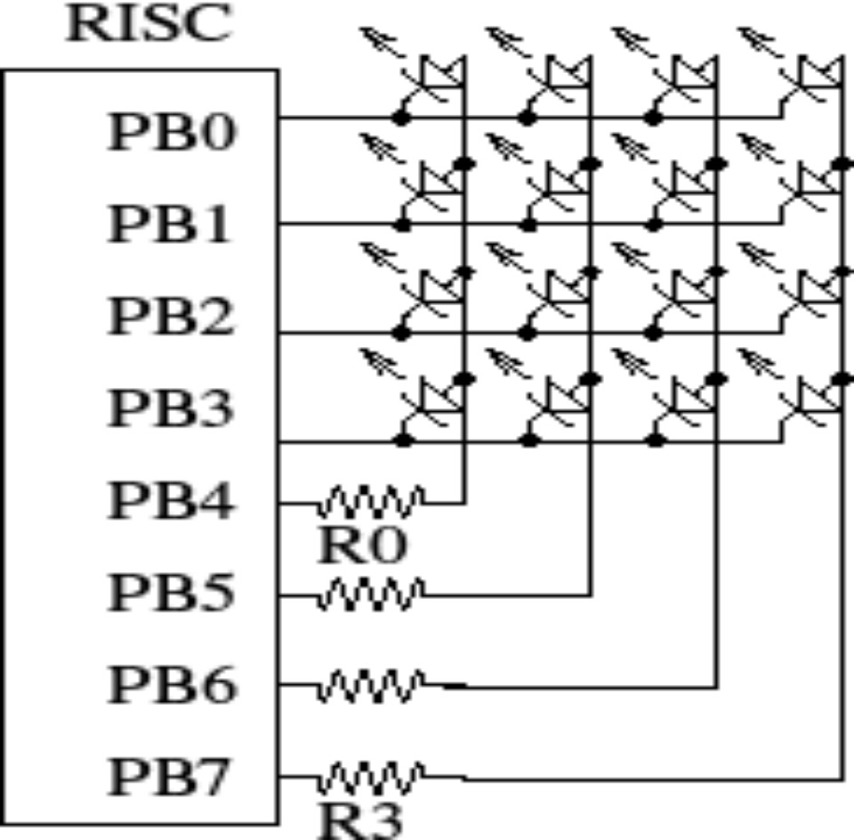
LED Scanned Interface

Slide 15
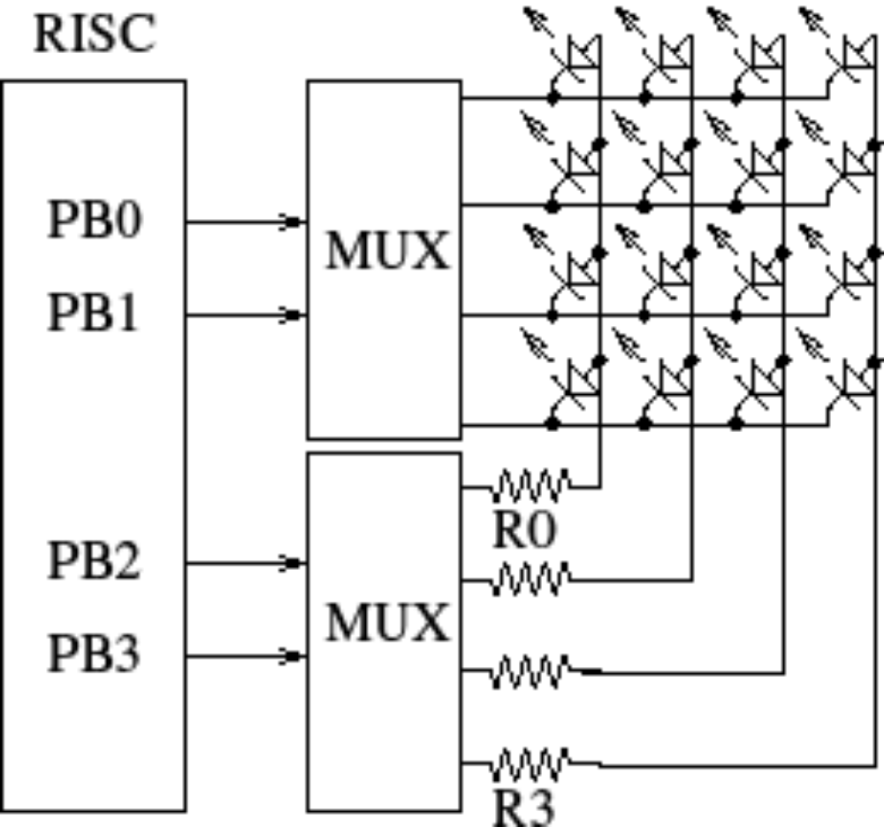
LED Interface using MUX

Slide 16
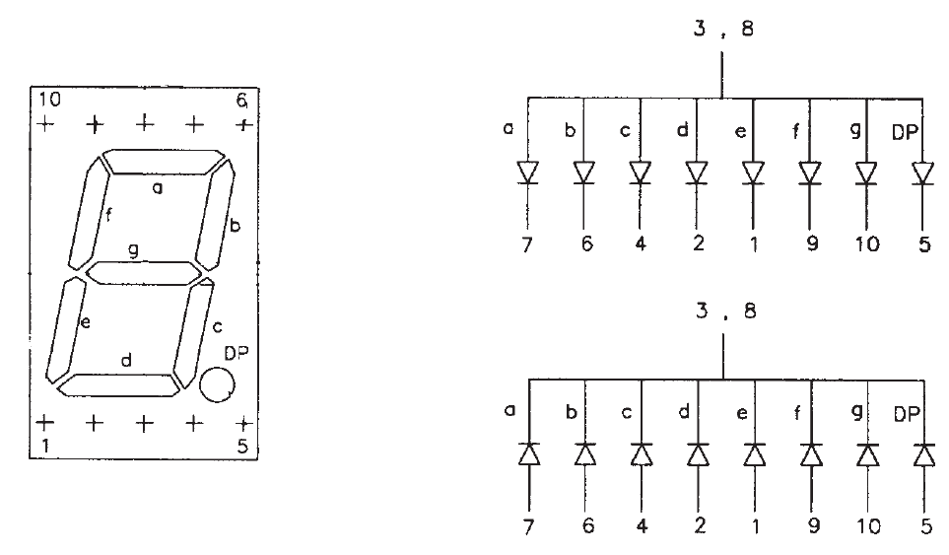
Seven-segment displays
Common Anode
Common Cathode

Slide 17
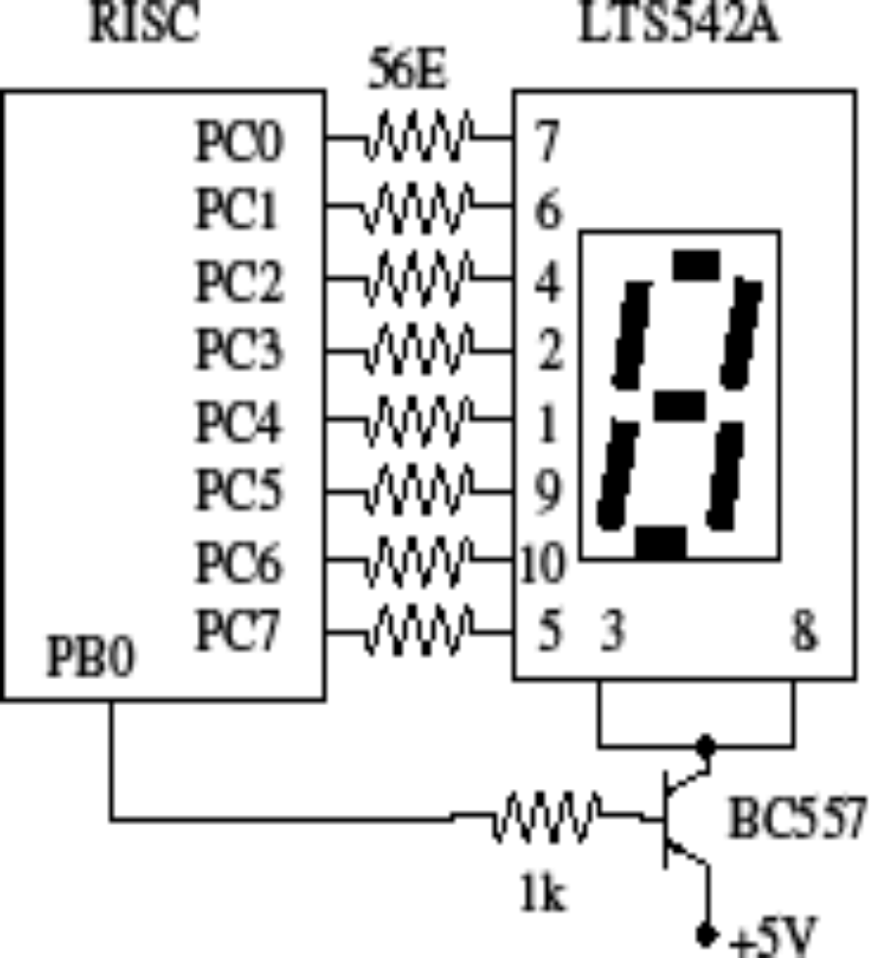
Common Anode

Slide 18
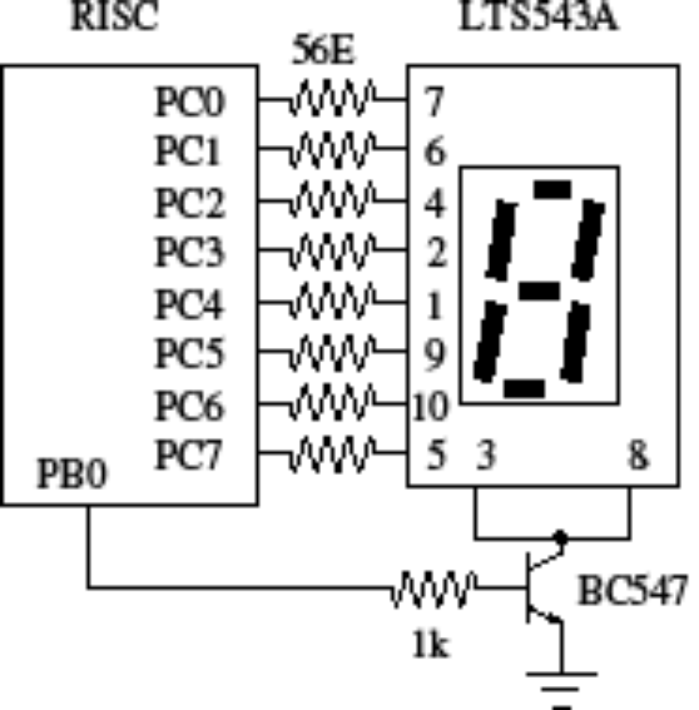
Common Cathode

Slide 19
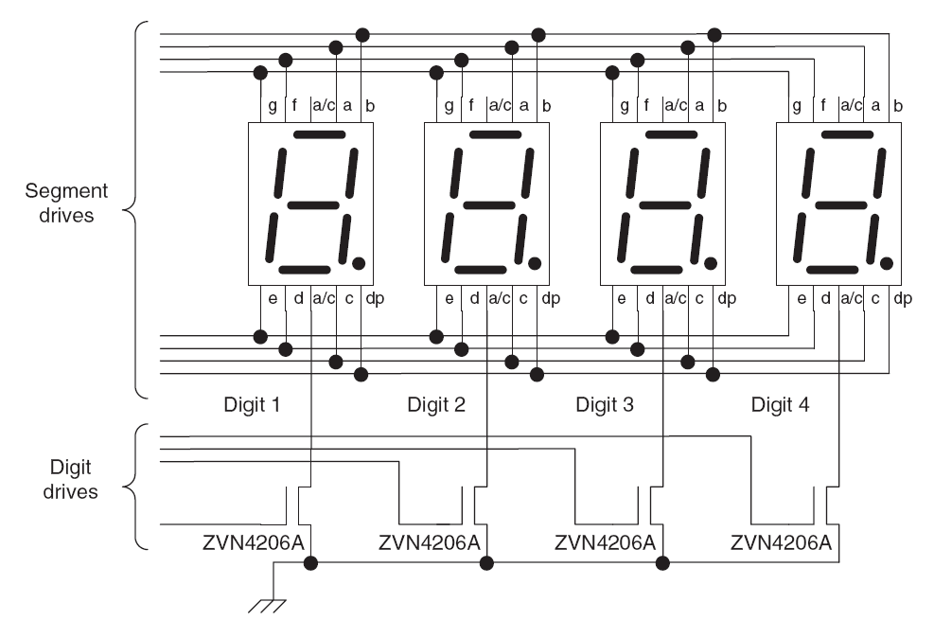
Connecting multiple digits
Need 1.2 kΩ line resistors

Slide 20
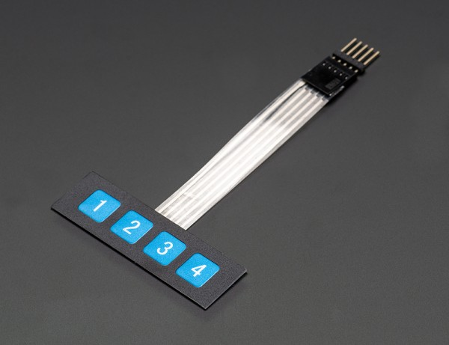
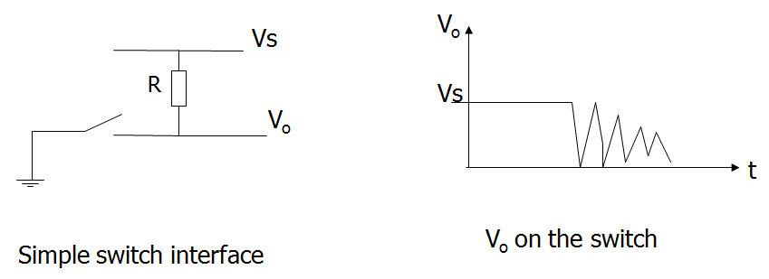
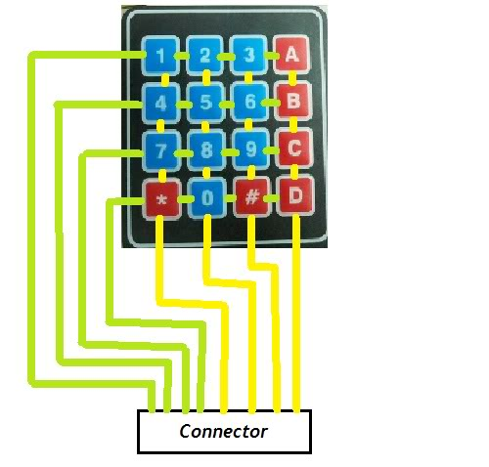
Switch bouncing

Slide 21
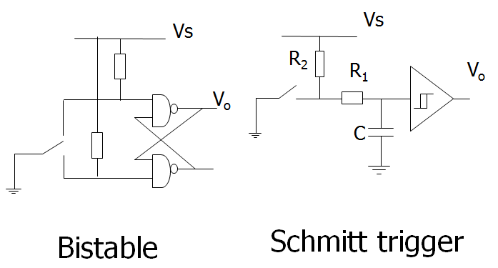
Hardware switch debouncing

Slide 22
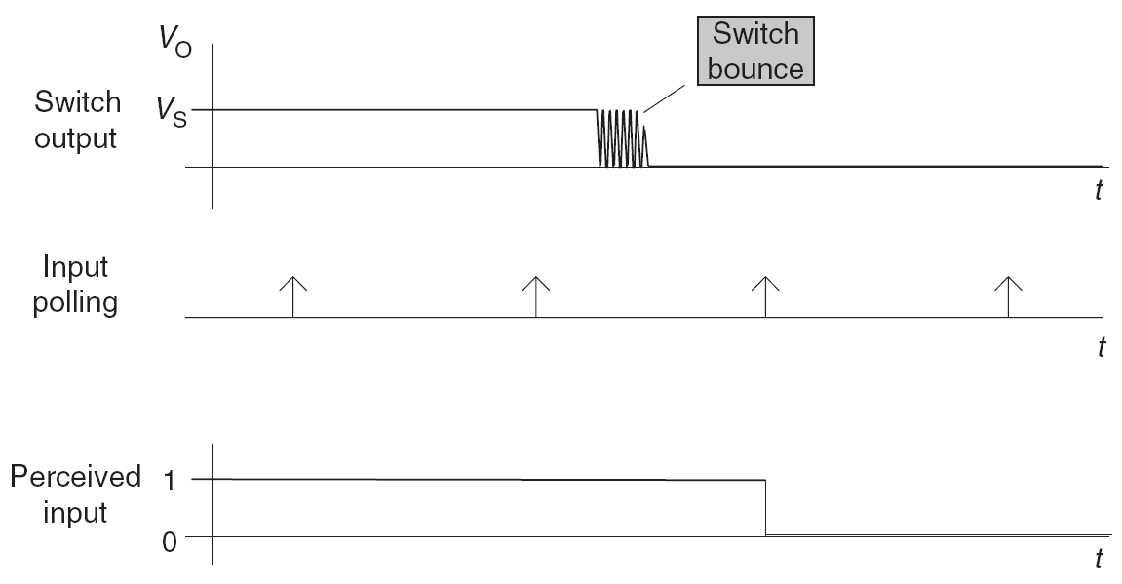
Software switch debouncing
Typically 10 ms

Slide 23
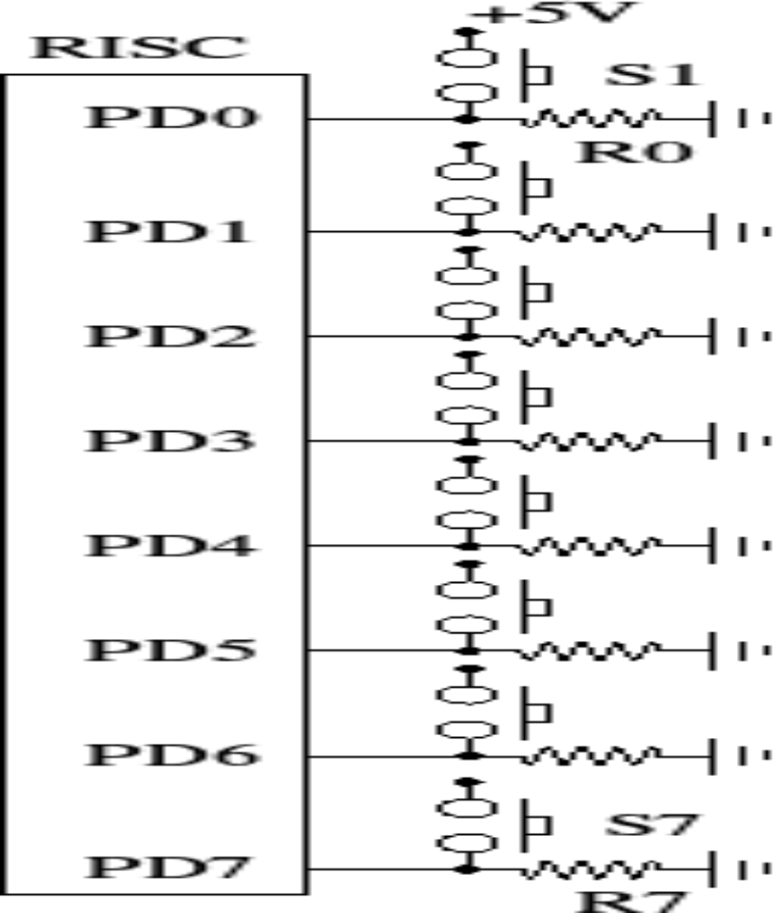
Direct Interface Key board

Slide 24
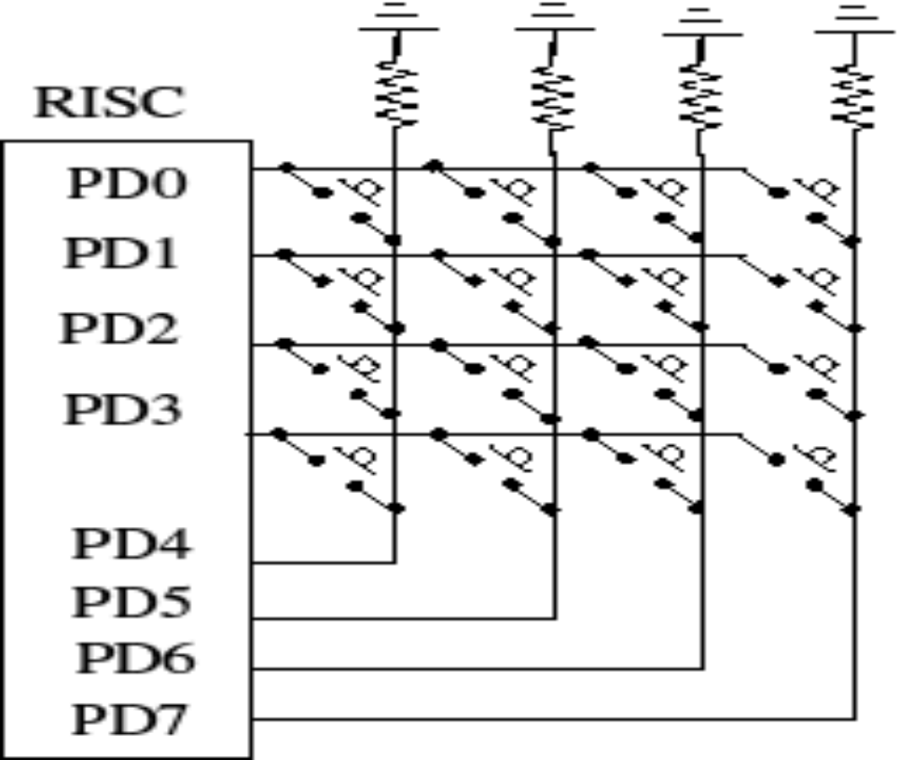
Scanned Interface Key board

Slide 25
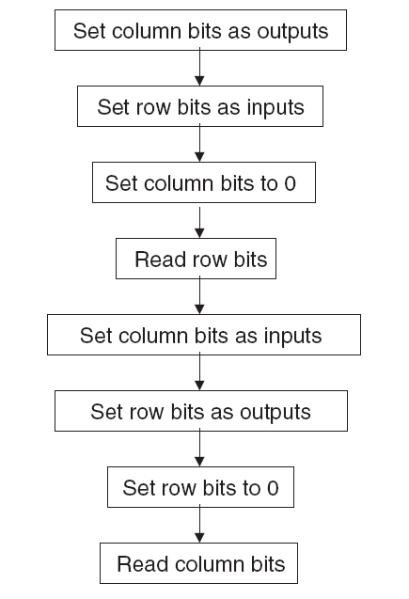
Flow diagram
Reading a keypad with a microcontroller port

Slide 26
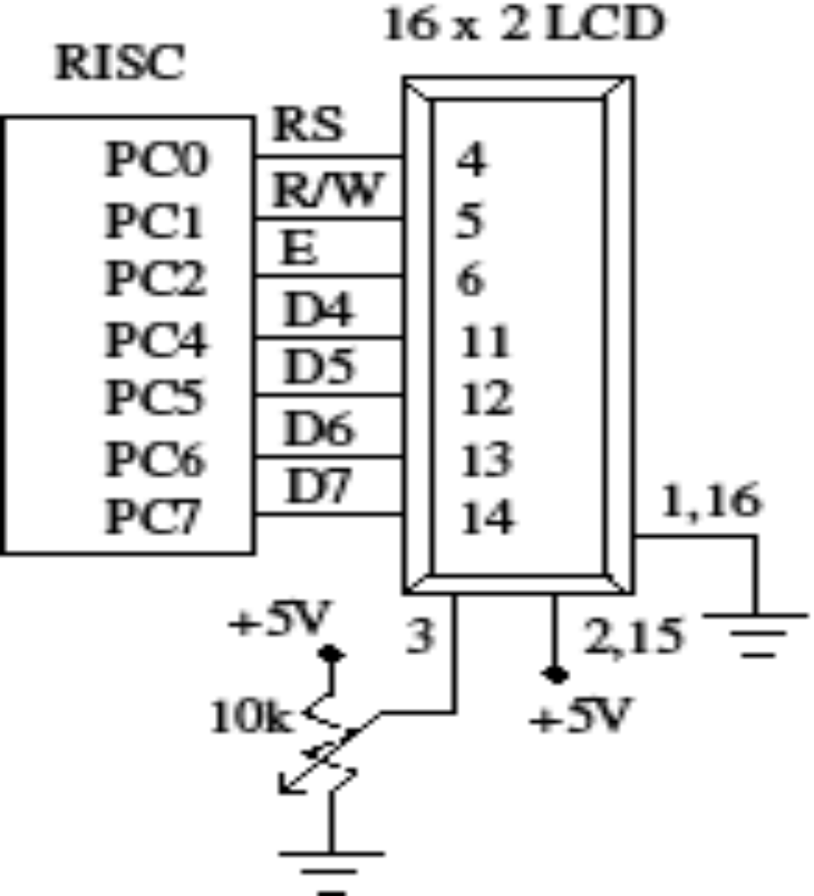
Text LCD Interface
Each digit is a liquid crystal dot matrix

Slide 27
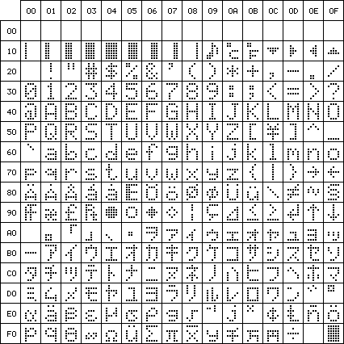
LCD ASCII Character Set
Standard upper and lower case alphabet and numeric characters are defined by the American Standard Code for Information Interchange (ASCII)
  Character codes between 20 Hex and 7F Hex
  Maintaining the same code for all equipment ensures that most text messages will be interpreted correctly
  The symbolic characters are often modified to suit design requirements

Slide 28
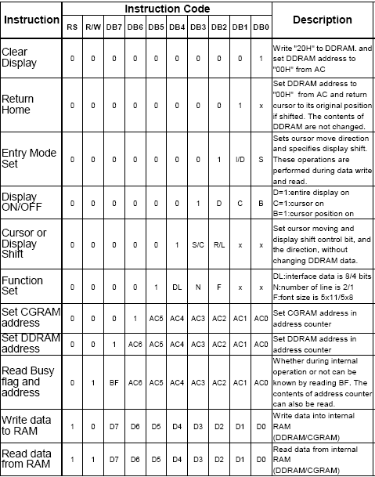
LCD Software Commands

Slide 29
Sensors
Convert physical variables to electrical.
Examples:
  The microswitch
  Light-dependent resistor
  Ultrasonic object sensor
  Optical sensor
  Hall sensor
  Temperature sensor

Slide 30
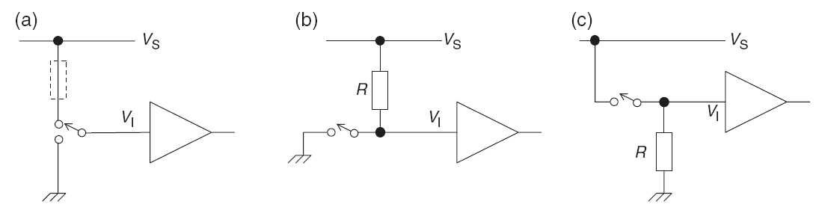
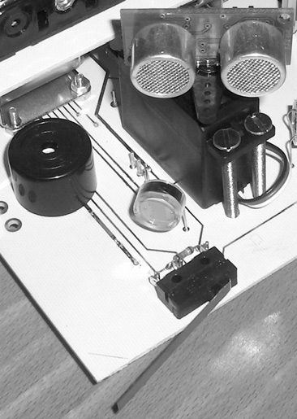
The Microswitch

Slide 31
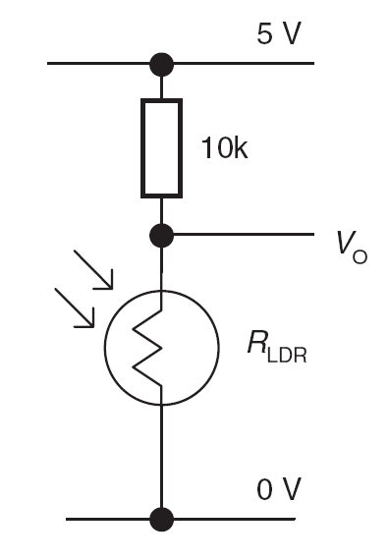
Light-dependent resistors
A light-dependent resistor (LDR) is made from a piece of exposed semiconductor material. When light falls on it, it creates hole–electron pairs in the material, which improve the conductivity.
20M Ω to a few hundred ohms

Slide 32
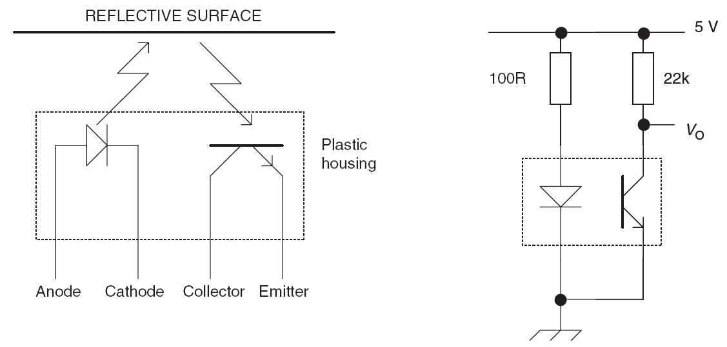
Optical object sensing
Infrared LED and phototransistor

Slide 33
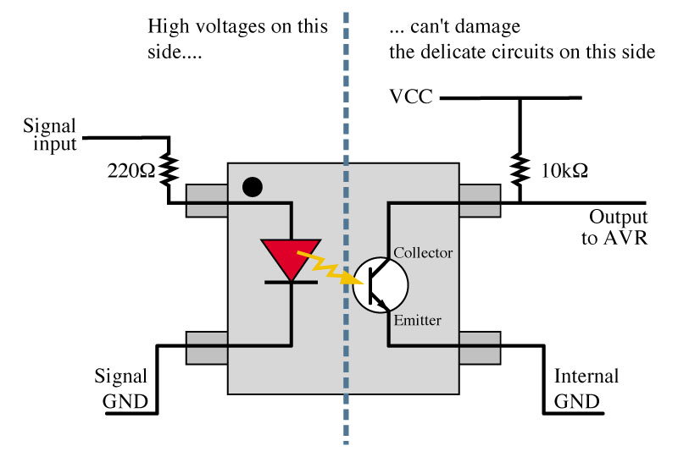
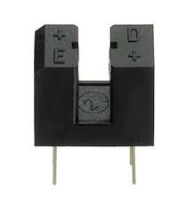
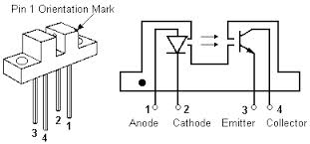
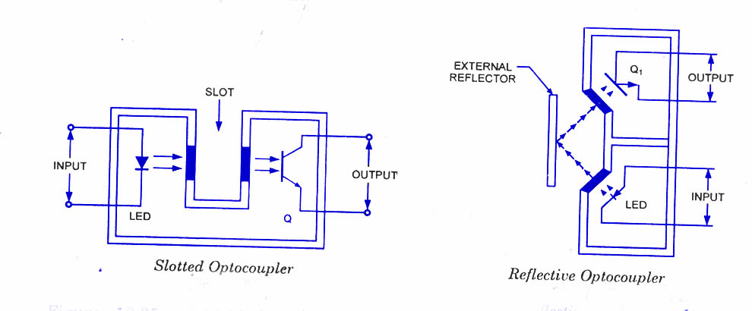
Optocoupler

Slide 34
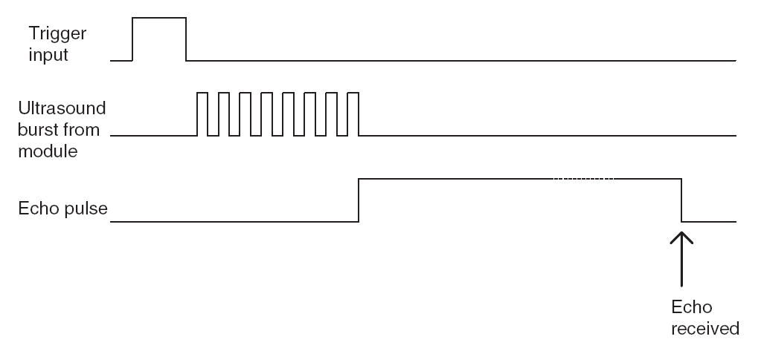
Ultrasonic object sensor

Slide 35
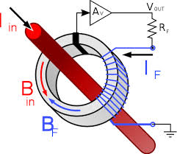
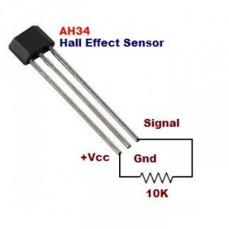
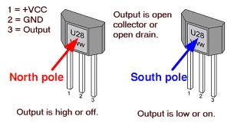
Hall Effect Sensor

Slide 36
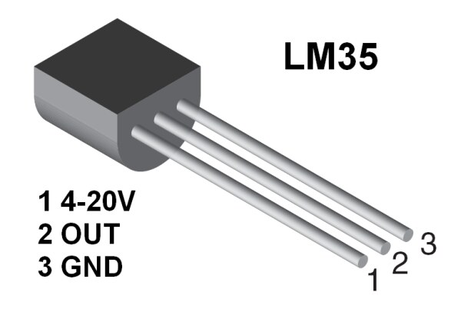
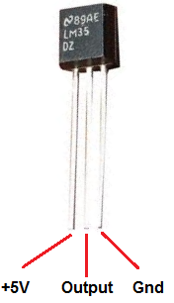
Temperature Sensor

Slide 37
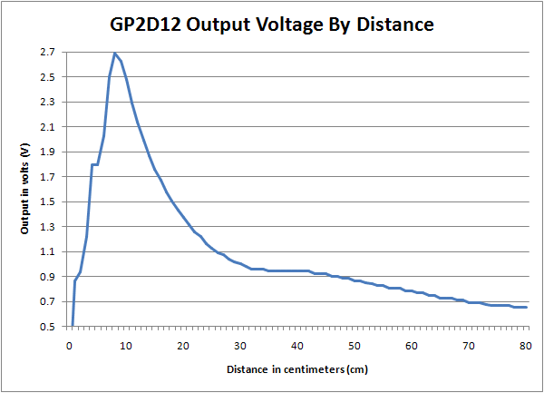
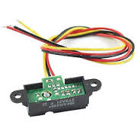
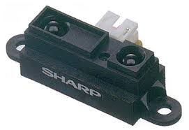
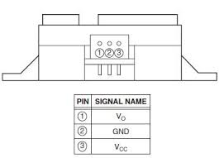
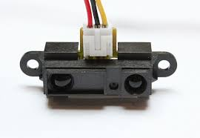
Distance Measurement

Slide 38
Interfacing to actuators
Simple DC switching
  Bipolar transistors
  MOSFET transistors
Reversible switching
  The H-bridge

Slide 39
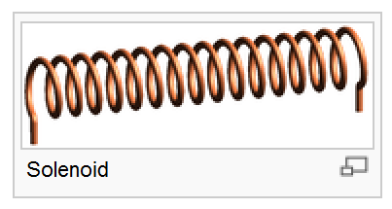
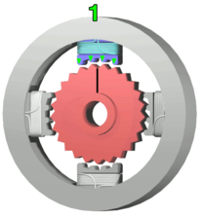
Actuators: motors and servos
Often need to cause physical movement
For linear movement use solenoids
For angular movement, use ‘servos’
For angular or rotary, use DC or stepper motors

Slide 40
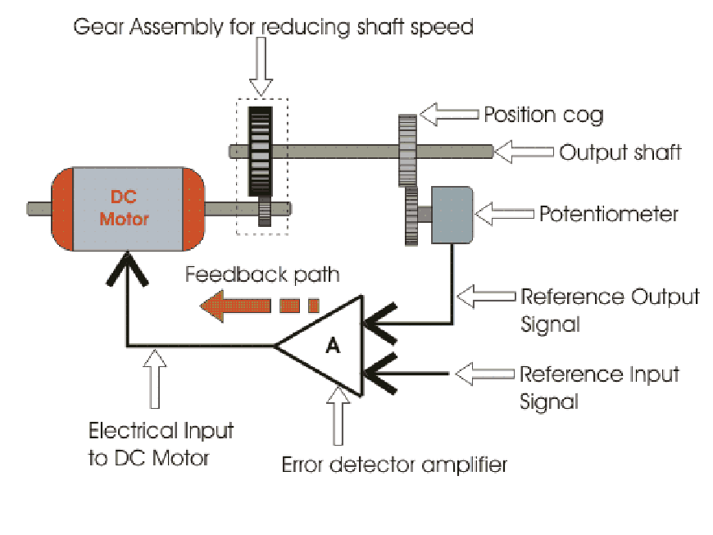
DC Servo Motor

Slide 41



DC Servo Motor

Slide 42

Servo input and output characteristics

Slide 43

Bipolar transistor switching of DC resistive loads

Slide 44

MOSFET transistor switching of DC resistive loads

Slide 45

MOSFET transistor switching of DC inductive loads

Slide 46

The L293D dual H-bridge

Slide 47

The L293D applied in the motor drive circuit

Slide 48

ULN2003 Driver

Slide 49
Summary
An embedded microcontroller must be able to interface with the physical world and possibly the human world as well.
Much human interfacing can be done with switches, keypads and displays.
To interface with the physical world, the microcontroller must be able to interface with a range of transducers. The designer needs an understanding of the main sensors and actuators available.
Interfacing with sensors requires a reasonable knowledge of signal conditioning techniques.
Interfacing with actuators requires a reasonable knowledge of power switching techniques.

